Slide 1

A Project Report on Micro Credit – Loan Defaulter
SUBMITTED BY
HIMAJA IJJADA
Caution - Please view the presentation as a slide show for better experience

Slide 2
TOPICS TO BE DISCUSSED
Introduction
Problem statement
Conceptual Background of the Domain Problem
Motivation for the Problem Undertaken
Mathematical/ Analytical Modeling of the Problem
Data Sources and their formats
Data Preprocessing Done
Visualizations
Model/s Development and evaluation
Key Findings and Conclusions of the Study

Slide 3
Introduction
A Microfinance Institution (MFI) is an organization that offers financial services to low income populations. MFS becomes very useful when targeting especially the unbanked poor families living in remote areas with not much sources of income. The Microfinance services (MFS) provided by MFI are Group Loans, Agricultural Loans, Individual Business Loans and so on.
Today, microfinance is widely accepted as a poverty-reduction tool, representing $70 billion in outstanding loans and a global outreach of 200 million clients.
We are working with one such client that is in Telecom Industry. They are a fixed wireless telecommunications network provider. They have launched various products and have developed its business and organization based on the budget operator model, offering better products at Lower Prices to all value conscious customers through a strategy of disruptive innovation that focuses on the subscriber.

Slide 4
What is Micro Credit?
Microcredit is an extremely small loan given to those who lack a steady source of income, collateral. It is used as a way to obtain a loan, acting as a protection against potential loss for the lender should the borrower default in his payments., or any credit history.
Importance of Micro Credit Defaulters Model.
Poverty alleviation programs provide material, funds, information and project services for people with no income or work opportunities. Because of the credit risks and relatively high costs associated with small loans, the traditional banking system is generally not willing to implement a microcredit system. The borrowers have no collateral to put up against loans and often are refused the needed capital because of the high risk of default. If they resort to underground sources, they are often charged exorbitant interest. This quick fix solution does not address the main structural problem: a lack of proper funding channels.

Slide 5
Problem statement
The sample data is provided to us from our client database. It is hereby given to you for this exercise. In order to improve the selection of customers for the credit, the client wants some predictions that could help them in further investment and improvement in selection of customers.
We have to build a model which can be used to predict in terms of a probability for each loan transaction, whether the customer will be paying back the loaned amount within 5 days of insurance of loan. In this case, Label ‘1’ indicates that the loan has been payed i.e. Non- defaulter, while, Label ‘0’ indicates that the loan has not been payed i.e. defaulter.

Slide 6
Conceptual Background of the Domain Problem
Telecom Industries understand the importance of communication and how it affects a person’s life, thus, focusing on providing their services and products to low income families and poor customers that can help them in the need of hour.
They are collaborating with an MFI to provide micro-credit on mobile balances to be paid back in 5 days. The Consumer is believed to be defaulter if he deviates from the path of paying back the loaned amount within the time duration of 5 days. For the loan amount of 5 (in Indonesian Rupiah), payback amount should be 6 (in Indonesian Rupiah), while, for the loan amount of 10 (in Indonesian Rupiah), the payback amount should be 12 (in Indonesian Rupiah).

Slide 7
Motivation for the Problem Undertaken
I have to model the micro credit defaulters with the available independent variables. This model will then be used by the management to understand how the customer is considered as defaulter or non-defaulter based on the independent variables.
They can accordingly manipulate the strategy of the firm and concentrate on areas that will yield high returns.
Further, the model will be a good way for the management to understand whether the customer will be paying back the loaned amount within 5 days of insurance of loan.
The relationship between predicting defaulter and the economy is an important motivating factor for predicting micro credit defaulter model.

Slide 8
Mathematical/ Analytical Modeling of the Problem
In this particular problem I had label as my target column and it was having two classes Label ‘1’ indicates that the loan has been payed i.e. Non- defaulter, while, Label ‘0’ indicates that the loan has not been payed i.e. defaulter. So clearly it is a binary classification problem and I have to use all classification algorithms while building the model. There was no null values in the dataset.
I observed some unnecessary entries in some of the columns like in some columns I found more than 90% zero values so I decided to drop those columns. If I keep those columns as it is, it will create high skewness in the model. To get better insight on the features I have used plotting like distribution plot, bar plot and count plot. With these plotting I was able to understand the relation between the features in better manner.
I have found outliers and skewness in the dataset so I removed outliers using percentile method and I removed skewness using yeo-Johnson method. I have used all the classification algorithms while building model then tuned the best model and saved the best model. At last I have predicted the label using saved model.

Slide 9
Data Analysis steps :
Import Libraries
Import Dataset
Data Pre Processing
Ordinal encoding
Visualization
Finding null values

Slide 10
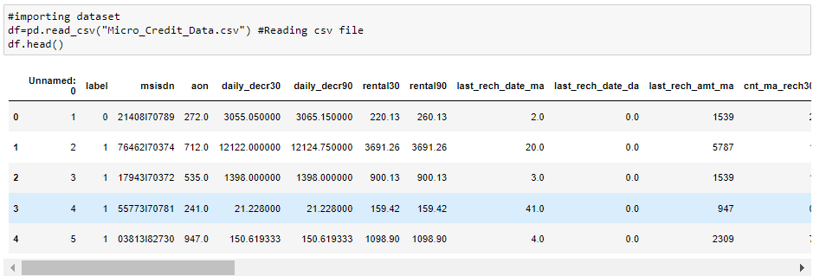
Data Sources and their formats
The sample data is provided to us from a client database is in CSV format.
In order to improve the selection of customers for the credit, the client wants some predictions that could help them in further investment.
The dataset has 209593 rows and 36 columns including target.
In this particular dataset I have object, float and integer types of data.

Slide 11
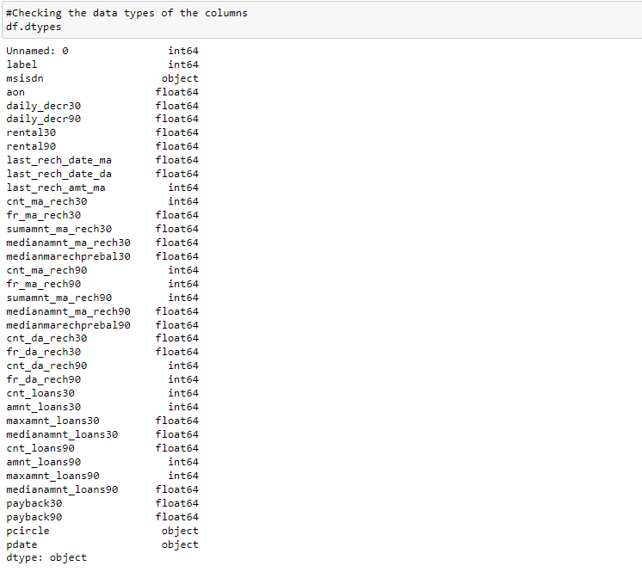
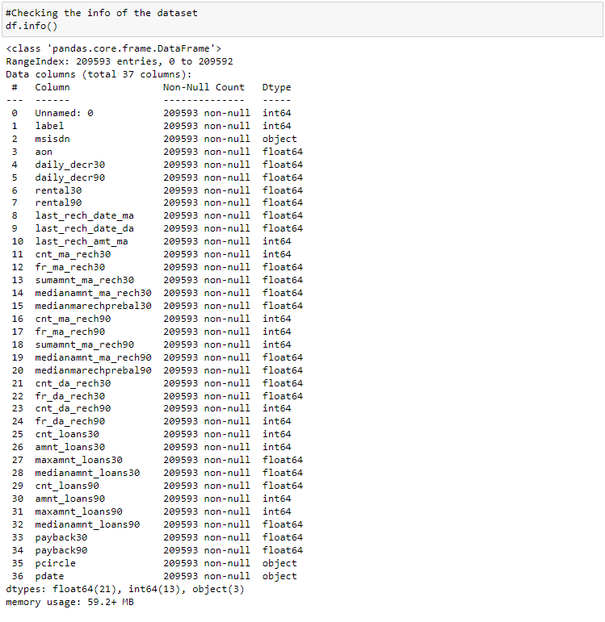
Data Preprocessing Done
Checking the data types of the columns
Checking the info of the dataset
We can observe that the data has 3 types of data - integer, float and object.
Observations
There are no null values in the dataset
We can see the datatypes of each column
The column 'pdate' should be a datetime datatype so we need to change it from object to datetime datatype.

Slide 12
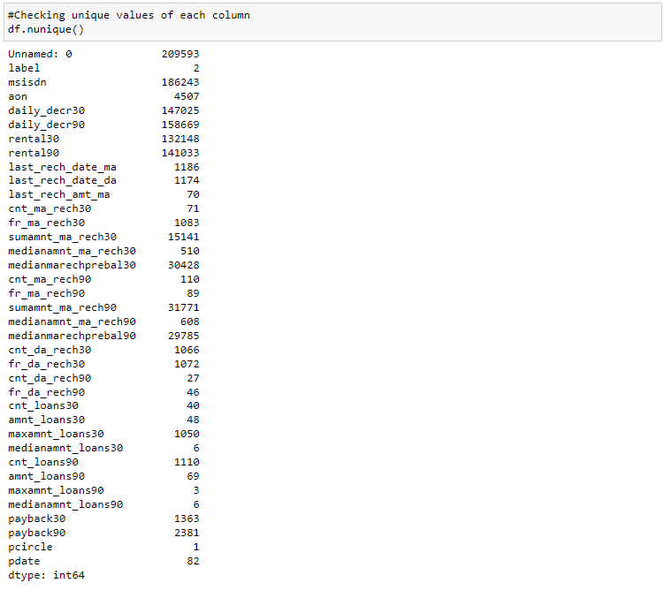

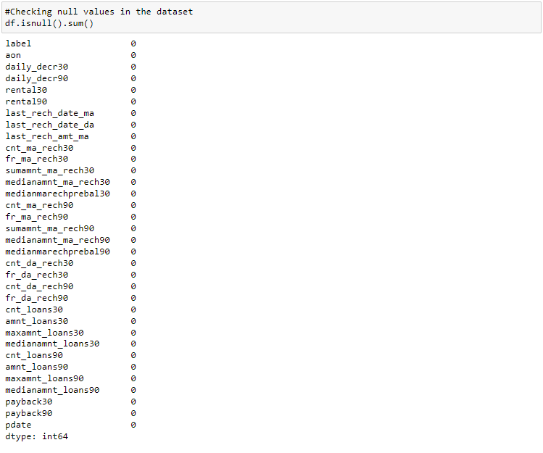
Checking unique values of each column
Dropping Unnamed: 0, msisdn and pcircle columns
We have dropped the above columns from our dataset
Checking null values in the dataset
Observations
'Unnamed:0' is an index column in raw dataset which has all the entries as unique numbers so we can drop this column.
The column 'pcircle' has only one entry in the column, which has no contribution with our model training. So we can drop this column also.
The column 'msisdn' is a column with phone numbers of users, which has no contribution to the model building. So this column can be dropped.

Slide 13
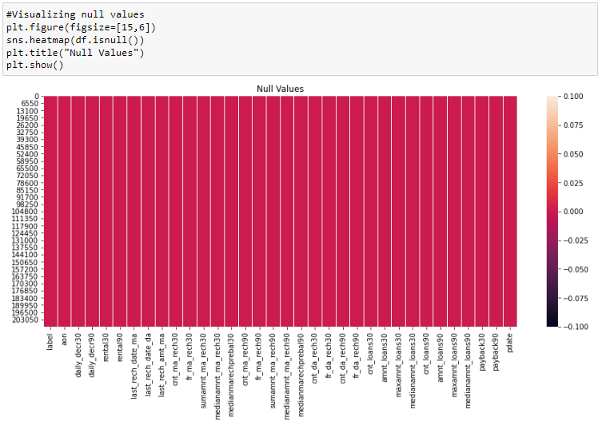
Visualizing null values
Observations
There are no null values in our dataset.

Slide 19
Software Used
Windows 10 Operating System
Anaconda Package and Environment Manager
Jupyter Notebook
Python3
Python Libraries used:
Pandas
Numpy
matplotlib, Seaborn
Scipy
Statsmodels
sklearn

Slide 20
Visualizations
Observations
We can clearly see that there is skewness in most of the columns so we need to treat them.
The following columns are skewed to the right
'daily_decr30'
'daily_decr90'
'rental30'
'rental90'
'last_rech_amt_ma'
'sumamnt_ma_rech30'
'medianamnt_ma_rech30'
'payback30'
'payback90'
'amnt_loans90'
'medianamnt_ma_rech90'
'fr_ma_rech90'
'cnt_ma_rech30'
'cnt_ma_rech90'
'sumamnt_ma_rech90'
The following columns are normally distributed
'aon'
'last_rech_date_ma'
'fr_ma_rech30'
'cnt_loans30'
'amnt_loans30'
'medianmarechprebal90'
'cnt_loans90'
'medianmarechprebal30'
Though some of the columns have integers as entries the data is considered categorical, so we need not take them into consideration.

Slide 21
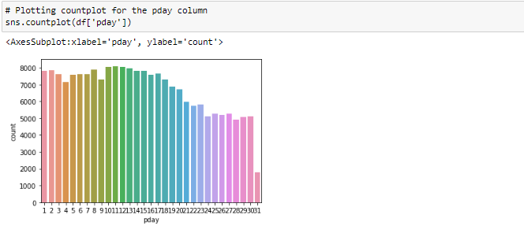
Observations
There is a data imbalance issue so we have to treat this by using oversampling or undersampling techniques.
Observations
All the days till third week of the month have similar no of entries
The last week of every month has lesser entries than the first 3 weeks

Slide 22
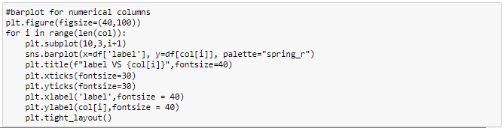
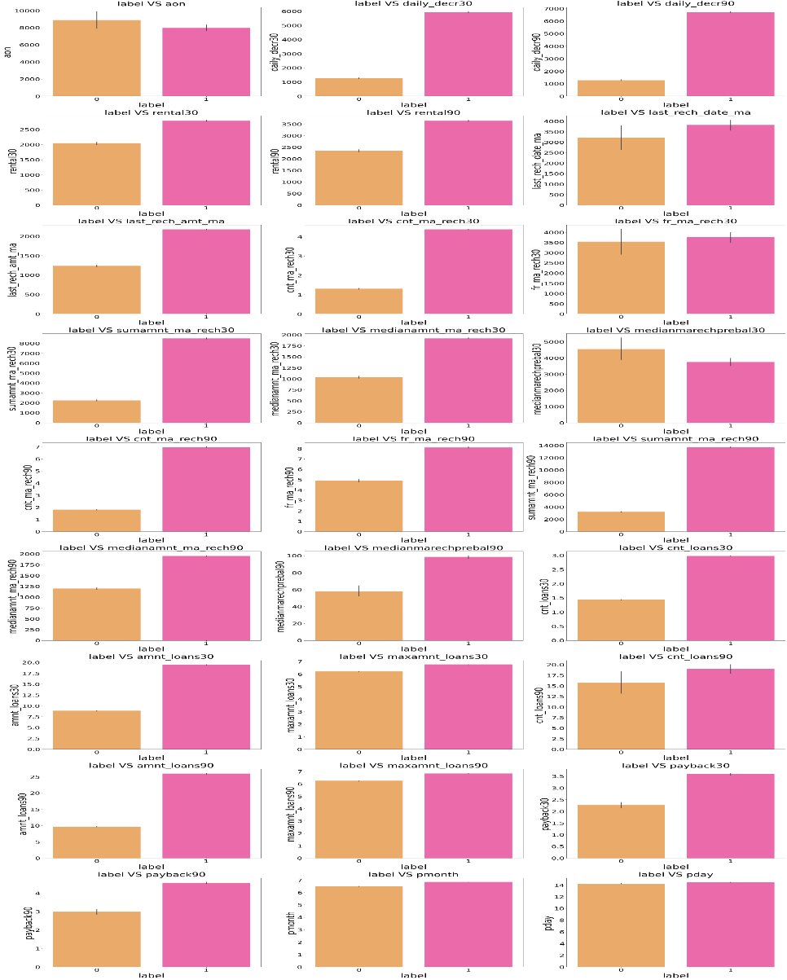
Bivariate Analysis

Slide 23
13. Customers with high value of Number of times main account got recharged in last 90 days(cnt_ma_rech90) are maximum Non-defaulters(who have paid there loan amount-1).
14. Customers with high value of Frequency of main account recharged in last 90 days (fr_ma_rech90) are maximum Non-defaulters (who have paid there loan amount-1).
15. Customers with high value of Total amount of recharge in main account over last 90 days (in Indonesian Rupiah) (sumamnt_ma_rech90) are maximum Non-defaulters (who have paid there loan amount-1).
16. Customers with high value of Median of amount of recharges done in main account over last 90 days at user level (in Indonesian Rupiah) (medianamnt_ma_rech90) are maximum Non-defaulters (who have paid there loan amount-1).
17. Customers with high value of Median of main account balance just before recharge in last 90 days at user level (in Indonesian Rupiah) (medianmarechprebal90) are maximum Non-defaulters (who have paid there loan amount-1).
18. Customers with high value of Number of loans taken by user in last 30 days (cnt_loans30) are maximum Non-defaulters (who have paid there loan amount-1).
19. Customers with high value of Total amount of loans taken by user in last 30 days (amnt_loans30) are maximum Non-defaulters (who have paid there loan amount-1).
20. Customers with high value of maximum amount of loan taken by the user in last 30 days (maxamnt_loans30) are maximum Non-defaulters (who have paid there loan amount-1).
21. Customers with high value of Number of loans taken by user in last 90 days (cnt_loans90) are maximum Non-defaulters (who have paid there loan amount-1).
22. Customers with high value of Total amount of loans taken by user in last 90 days (amnt_loans90) are maximum Non-defaulters (who have paid there loan amount-1).
23. Customers with high value of maximum amount of loan taken by the user in last 90 days (maxamnt_loans90) are maximum Non-defaulters (who have paid there loan amount-1).
24. Customers with high value of Average payback time in days over last 30 days (payback30) are maximum Non-defaulters (who have paid there loan amount-1).
25. Customers with high value of Average payback time in days over last 90 days (payback90) are maximum Non-defaulters (who have paid there loan amount-1).
26. In between 6th and 7th month maximum customers both defaulters and Non-defaulters have paid there loan amount.
27. Below 14th of each month all the customers have paid there loan amount.

Slide 24
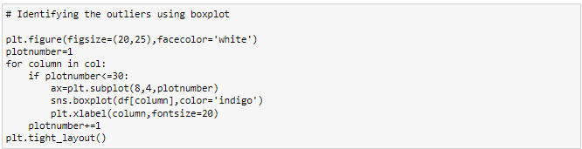
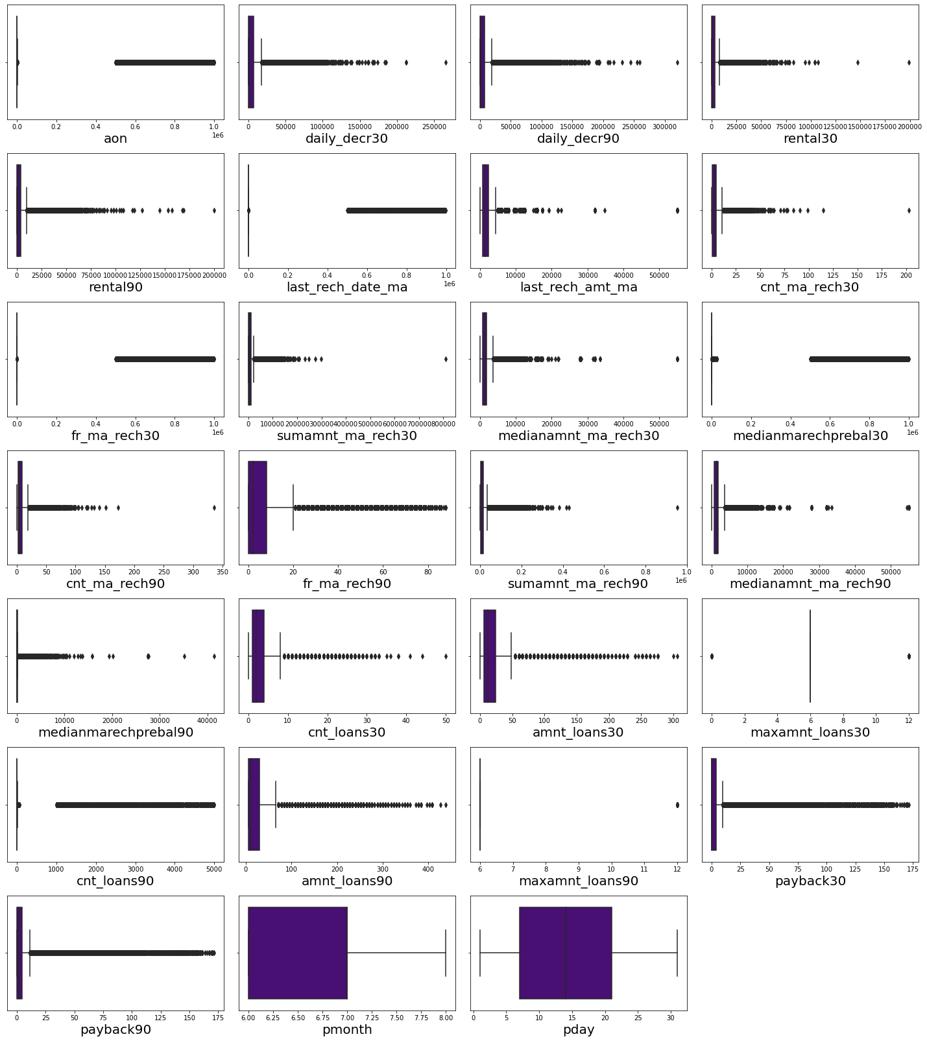

Checking for outliers:
Identifying the outliers using boxplot
Removing Outliers in train dataset:
I. Z score method
Using Z-score method for train dataset the data loss is more than 10% so let us have a look into IQR method to remove outliers.
II. IQR method
In IQR method the data loss is more than 10% so let us have a look into percentile method to remove outliers.
III. Percentile method
We have successfully removed outliers in train dataset using percentile method.

Slide 25
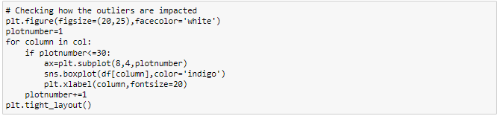
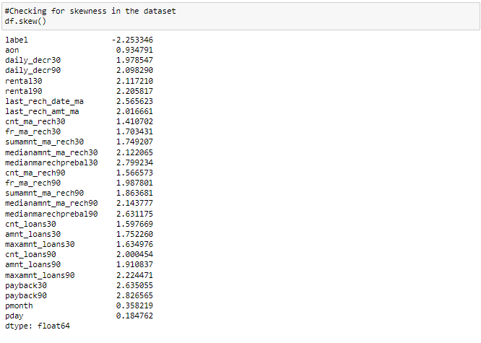
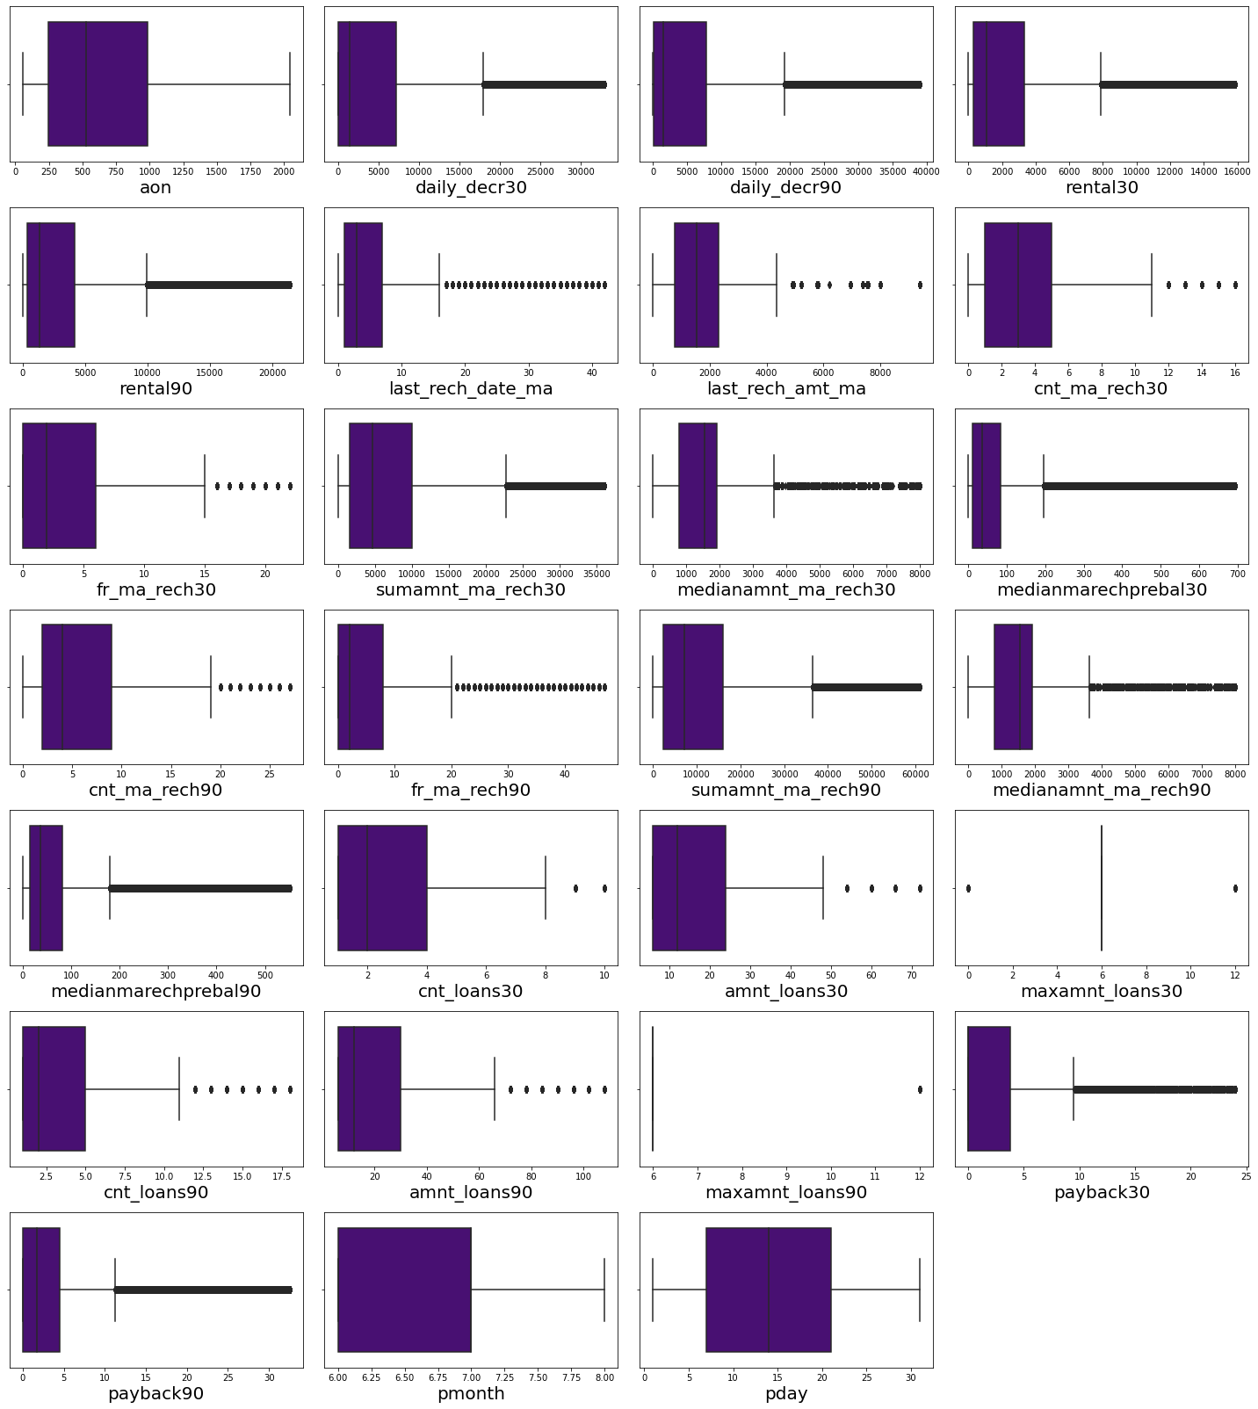
Checking how the outliers are impacted
Checking for skewness:
Observations
There is skewness in almost all columns except pmonth,pday and as label is my target i should not remove skewness from this column.
Observations - We can observe that the Outliers has been significantly reduced in all the columns.

Slide 26
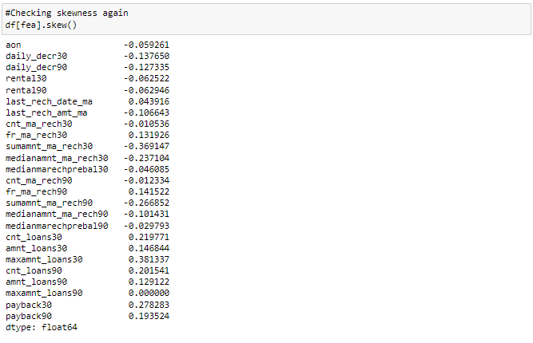
Skewness in all the columns has been reduced.
The skewness has been removed from the dataset.

Slide 27
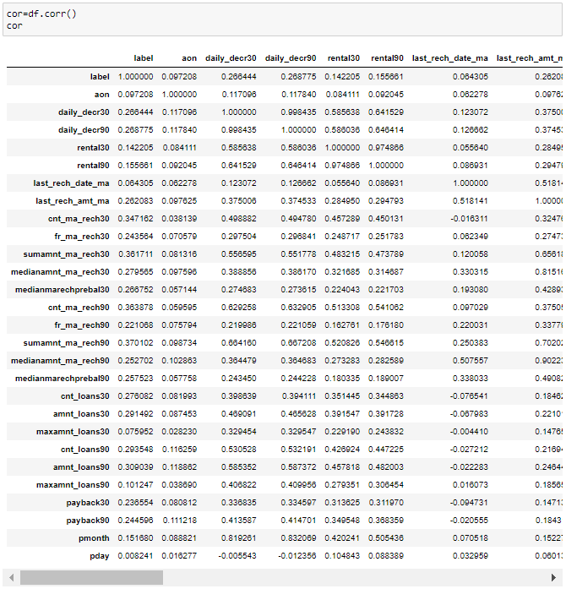
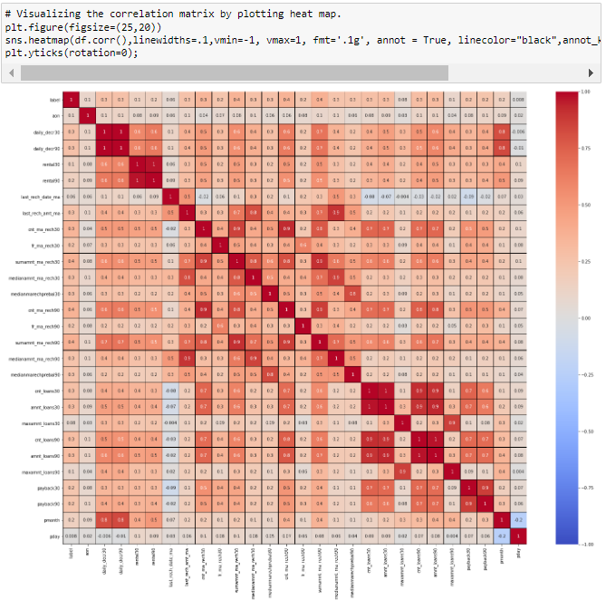
Correlation
Visualizing the correlation matrix by plotting heat map.
Observations
Above are the correlations of all of the features. To get better visualization on the correlation of features, let us plot it using a heat map.
Observations
We can observe that there are some features which are positively correlated with other features which says there is multicollinearity in the dataset. We need to treat the multicollinearity before building a model.

Slide 29
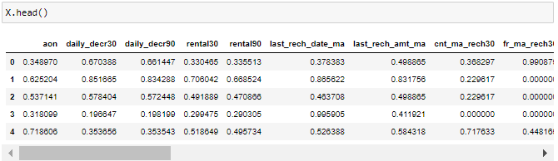
Model/s Development and evaluation
Separating features and label in train dataset
We have separated the target and independent columns.
Scaling
We have scaled the data using MinMax scaler
Viewing the data after scaling
This is the data of independent variables after scaling.

Slide 30
Balancing

Slide 31
By looking into the difference of model accuracy and cross validation score i found BaggingClassifier as the best model with 95.16% accuracy and the difference between model accuracy and cross validation score is 0.44.

Slide 32
Above is the ROC curves for all the models that we have predicted. The AUC values can also be seen in the plot.
AUC values for XGBClassifier and BaggingClassifier are higher compared to other models. We have least difference in model accuracy and cross validation score for BaggingClassifier so BaggingClassifier can be considered the best model to proceed with hyper parameter tuning.

Slide 37
Key Findings and Conclusions of the Study
I found that the dataset was quite interesting to handle as it contains all types of data in it. Improvement in computing technology has made it possible to examine social information that cannot previously be captured, processed and analyzed. New analytical techniques of machine learning can be used in property research.
The power of visualization has helped us in understanding the data by graphical representation it has made me to understand what data is trying to say. Data cleaning is one of the most important steps to remove unrealistic values and zero values. This study is an exploratory attempt to use four machine learning algorithms in estimating micro credit defaulter, and then compare their results.
To conclude, the application of machine learning in micro credit is still at an early stage. We hope this study has moved a small step ahead in providing some methodological and empirical contributions to crediting institutes, and presenting an alternative approach to the valuation of defaulters. Future direction of research may consider incorporating additional micro credit transaction data from a larger economical background with more features.

Slide 38
Thank you

